Slide 1
Fiscal Sustainability Advanced and Emerging Economies
December 18, 2023
By Haya Abusharar, Mahyar Alizadeh, Erin Cooper, Melina Hernandez, Andrew Jessberger
Notes:
Hello everyone today we will be discussing the Fiscal Sustainability of Advanced and Emerging Economies

Slide 2
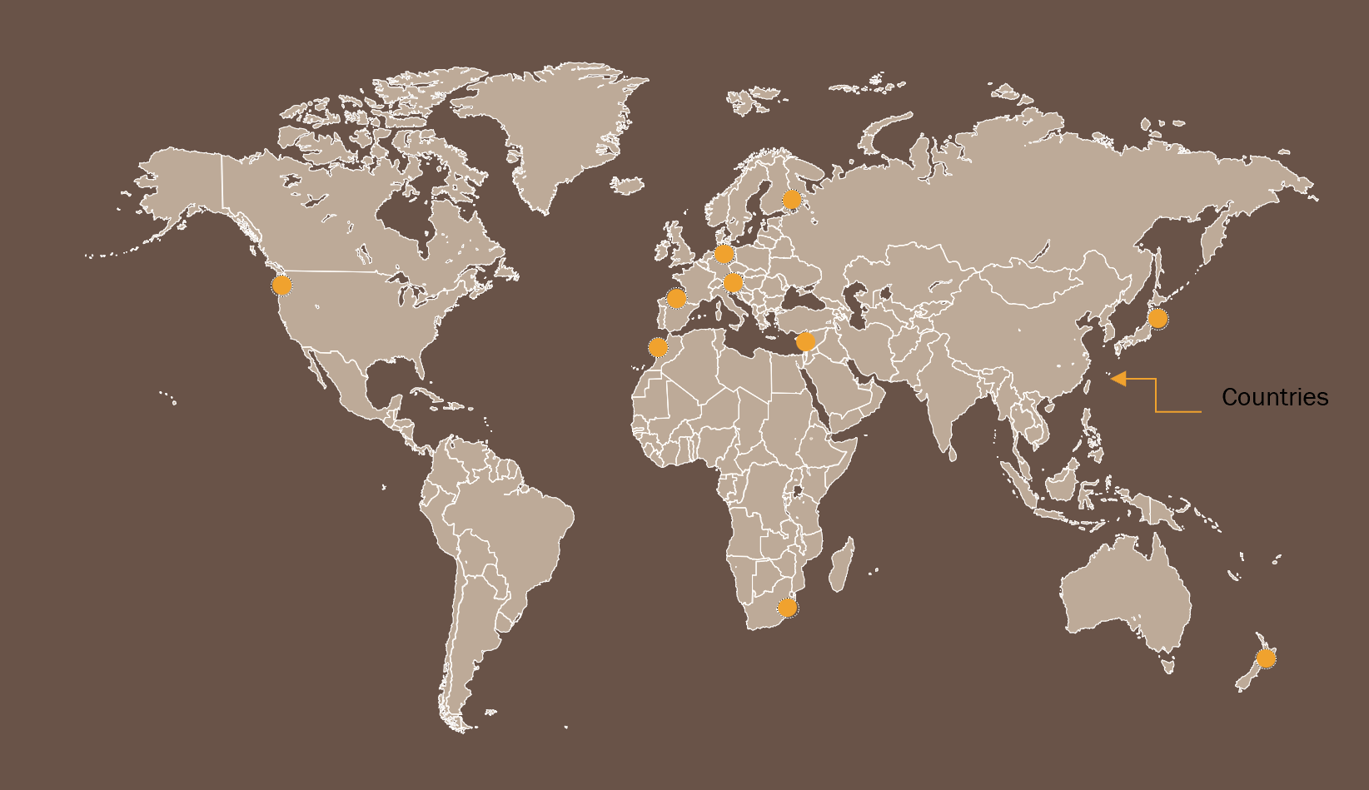
Executive summary
Project Overview:
Comparative analysis of National Debt
Aims to find clear trends and correlation
Time frame: 2018-2023
Advanced Economies:
The United States of America (USA), New Zealand,(NZL) Germany(DEU), Finland(FIN), Japan(JPN), Spain(ESP)
Emerging Economies:
Croatia(HRV), Chile(CHL), Morocco(MAR), South Africa(ZAF), Jordan(JOR), Hungary(HUN)
Notes:
For this project we are assessing the fiscal sustainability of advanced and emerging countries by selecting six countries in each category. In this case our advanced countries are the United States of America, New Zealand, Germany, Finland, Japan, and Spain. The emerging countries are Croatia, Chile, Morocco, South Africa, Jordan, and, Hungary.
This project aims to identify any clear trends among the selected countries and find possible correlations between population dynamics and financial outlook.
The selected time frame for for this project spans six years from 2018 to 2023.
The time frame was selected to parallel the COVID-19 pandemic from 2018 to 2019 (pre-covid-19), 2020 to 2021 (during covid-19) and 2022 to 2023 (post covid-19).

Slide 3
Overview of Data
Data Source
World Economic Outlook(WEO), 2018-2023. Published by the IMF
Describe the collection, exploration, and cleanup process.
Conducted Analysis on National Debt focusing on selected countries and several indicators by suggested questions.
Define the Selected selection of group and dataframe.
Dataset includes several key economic indicators.
Analyzed correlations and patterns within the data.
Notes:
For this comparative analysis of the National Debt of advanced and emerging economies we got our data from the World Economic Outlook (WEO). The WEO is a biannual publication that provides statistical data on output, inflation, employment, fiscal balances, and debt for member countries. The WEO also contains the IMF's analysis and projections of economic developments globally.
This source was beneficial for this analysis as we were attempting do see National debt over a multitude of years and were comparing many different macroeconomic variables.
When collecting our data we began by asking questions about National debt and discussing what we wanted to know. We then defined the selected groups and dataframe and analyzed correlations and patterns within the data.
We then determined what variables would be best to analyze in order to answer our questions.
The cleanup process of this code included multiple trials where we attempted to see what code worked and what was unnecessary.
An overview of the data collection, cleanup, and exploration processes:
Describe the source of your data and why you chose it for your project.
World Economic Outlook(WEO)
Describe the collection, exploration, and cleanup process.
Description of source data:
Why this source was chosen:
Benefits of source:
What we did to collect the data:
How/why we chose macroeconomic variables:
Cleanup process of code:

Slide 4
Approach to Project Goals
Approach to goals:
Aimed to find trends and correlations by breaking down data
Focused Analysis on the specific dataframes (group of countries and specific key indicators comparison with National Debt).
Formulated specific questions to guide in the analysis process.
Code Application:
Jupyter Notebook and VSCode to run the codes.
Python for programming language.
Code libraries and modules: Requests, Pandas, Time, JSON, Seaborn, Matplotlib and NumPy.
Unanticipated insights/problems:
Narrowing the scope of the project queries.
Determining the correct information to pull via the WEO API using different EndPoints.
Generating the correct labels from a specific dataset (WEO), the API contained many datasets.
Creating an easy to understand summarization.
Some indicators by end of CY to be reported, due to that, few indicators had a value of 0 in the analysis.
Notes:
For this project our team approached our goals by first aiming to find any trends or correlations in our data. We then focused on the analysis of specific dataframes and formulated specific questions to guide this analytical process.
For the code application we use Jupyter Notebook and VSCode to run the codes. Python for the programming language.
Throughout the course of this project we did run into a multitude of unanticipated insights and problems such as narrowing down the scope of out project queries, determining the correct data to pull, generating correct labels, creating an easy to read summarization, and finding some gaps in our data to unreported statistics.
How we approached our goals:
The approach that your group took to achieve the project goals:
Include any relevant code or demonstrations of the application or analysis.
Discuss any unanticipated insights or problems that arose and how you resolved them.

Slide 5
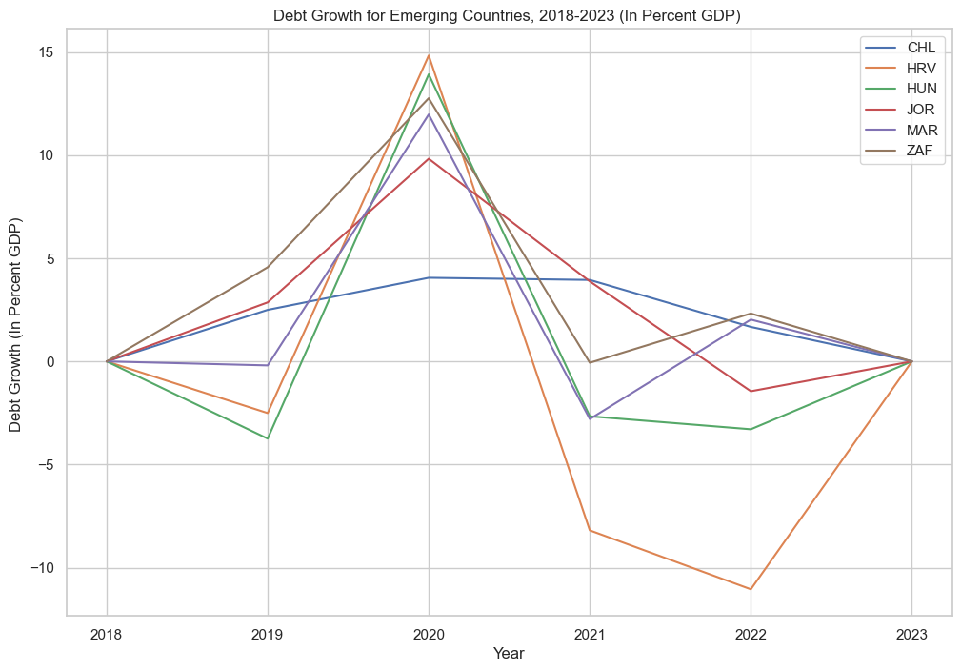
National Debt Growth for Emerging Countries, 2018-2023
Notes:
In this section we looked for changes in the national debt of our Advanced and Emerging countries before, during, and after the COVID-19 pandemic.
1. Debt Growth Overall.
All countries saw spikes in debt growth in 2020 but Germany (in Advanced) and Chile (in Emerging) demonstrated the least dramatic fluctuation in debt.
Most countries, with the exception of Germany and Croatia, show debt trending upward once more leading into 2023.
2. Advanced Economies.
All countries in Advanced Economies (except Germany) showed a sharp spike in debt in 2020, followed by a sharp dip in 2021/2022. Germany’s economy shows a gradual rise and gradual decline leading into 2023.
Spain’s economy showed some interesting fluctuation with their debt decreasing dramatically before rising again in 2022-2023.
3. Emerging Economies.
While these countries show debt increases in 2020, their debt does not fluctuate as dramatically as those in the Advanced Economies.
Chile’s debt does not spike in 2020 but has continued on a steady increase into 2022.
4. Statistical anomalies.
Due to the fact that there is no data for the year 2023, all values show as “zero.” (So 2023 doesn’t actually show a dramatic debt decrease).
5. Possible conclusions/further questions.
While the data indicates the COVID-19 pandemic contributed to a spike in debt overall in 2020, not all economies seem to be impacted in the long term. In fact, a few countries saw little variance.
For the countries that saw little impact to debt in 2020, what factors may have contributed? (Economic policies, trade factors, etc.)
What factors (besides covid) contributed to steep fluctuation in debt in the rest of the countries?

Slide 6

National Debt Growth for Advanced Countries, 2018-2023
Notes:
3. Emerging Economies.
While these countries show debt increases in 2020, their debt does not fluctuate as dramatically as those in the Advanced Economies.
Chile’s debt does not spike in 2020 but has continued on a steady increase into 2022.
4. Statistical anomalies.
Due to the fact that there is no data for the year 2023, all values show as “zero.” (So 2023 doesn’t actually show a dramatic debt decrease).
5. Possible conclusions/further questions.
While the data indicates the COVID-19 pandemic contributed to a spike in debt overall in 2020, not all economies seem to be impacted in the long term. In fact, a few countries saw little variance.
For the countries that saw little impact to debt in 2020, what factors may have contributed? (Economic policies, trade factors, etc.)
What factors (besides covid) contributed to steep fluctuation in debt in the rest of the countries?

Slide 7
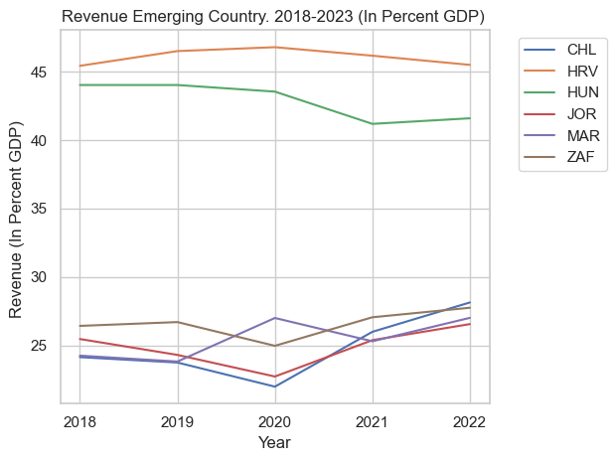
Revenue (% GDP) in Emerging Countries, 2018-2023
Notes:
GDP growth rate seems to have an inverse correlation with debt. Governments borrowing to aid in the slowdown: economic relief, COVID-19, etc.
Morocco has a pretty big uptick in government revenue (%GDP). No other nation sees that big of an uptick. Morocco experienced the same increase in unemployment
GDP per Capita doesn’t move very much. It remains level, with a slight downturn 2019-2020. Population didn’t change Take a look at the GDP growth overall and compare.

Slide 8
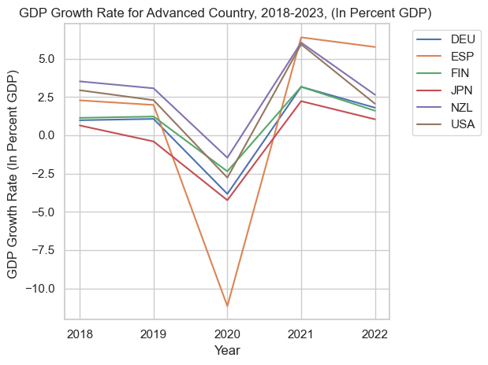
GDP Growth Rate in Advanced Countries, 2018-2023

Slide 9
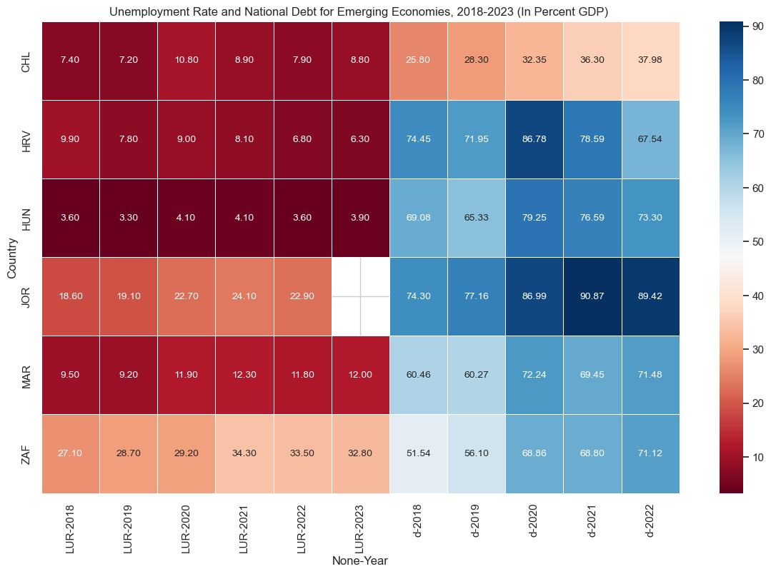
Heatmap for Unemployment Rate and National Debt for Emerging Countries, 2018-2023 (in percent GDP)
Notes:
Population Growth:
•Both groups, comprising advanced and emerging economies, demonstrated consistent population growth.
•Population growth did not exhibit a clear trend concerning fluctuations in national debt.
•A marginal impact on the unemployment rate was noted during the global event of 2020, primarily driven by the COVID-19 pandemic.
● Japan had a decreased in population due to the fact death rates outpaced birth rates.
2.Unemployment Rate
1.Advanced Economies:
•Notably, the unemployment rate in advanced economies displayed a discernible trend closely aligned with changes in national debt.
•The observable shifts in industrial activity, possibly suspended or resumed in 2021, had notable repercussions on the economy and revenue.
● 2 countries suffered from an increase in national debt due to the fact that they had a change in commodity prices due to Russia/Ukraine War.
2.Emerging Economies:
•Similarly, the unemployment rate in emerging economies mirrored the trend seen in advanced economies.
•A significant surge in national debt in 2020 was observed, likely attributed to lending policies associated with government strategies and central banking practices.
•Some emerging economies faced challenges in recovering from the impacts of the COVID-19 pandemic, including with an assumption of difficulties in savings and investments.
•In a specific subset of three countries, an intriguing anomaly was observed: a rise in the debt despite a gradual decrease in unemployment rate. This anomaly could be indicative of various factors, such as economic downturns, global events (e.g., inflation), specific government policies, or demographic shifts
The countries that suffered of an increase in 2022 of national debt though there has been decrease in unemployment rate, CHL due to the fact of reforming new government in 2022, JOR being affect by external shocks(e.g. Wars in neighboring countries), and MAR which is had a change in commodity prices due to Russia/Ukraine War.

Slide 10
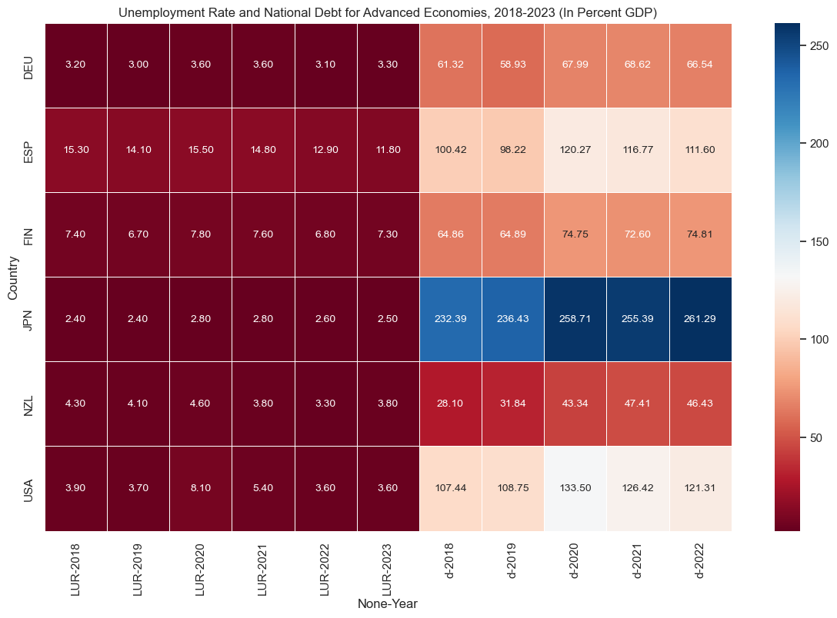
Heatmap for Unemployment Rate and National Debt for Advanced Countries, 2018-2023 (in percent GDP)

Slide 11
Results/Conclusions
Suggests exploring additional factors and variables that might influence the observed unusual trends, including economic indicators, specific government policies, demographic changes, and global events might affect those countries.
Advanced Countries:
Unemployment rates are relatively low for advanced countries,
National debt shows variations among countries, with the USA having the highest average.
Emerging Countries:
Unemployment rates are higher on average..
Considerations:
The findings are based on the specified indicators and time span.
Some data may be missing or incomplete, as indicated by NaN values in the DataFrames.
Interpretation may require domain-specific knowledge and a deeper understanding of economic indicators.
Notes:
The results/conclusions of the application or analysis:
Include relevant images or examples to support your work.
Figures/Graphs that proves our results
If the project goal was not achieved, discuss the issues and how you attempted to resolve them.
These findings provide a robust foundation for more in-depth exploration and future research, aiming to gain a nuanced understanding of the intricate economic dynamics influencing the national debt in both advanced and emerging economies. The study provides valuable insights into the economic dynamics of advanced and emerging economies, emphasizing the need for continuous analysis and adaptation to evolving global circumstances. Consideration of potential data gaps and the necessity for domain-specific knowledge reinforces the importance of ongoing research for a more comprehensive understanding of economic indicators. More findings can be listed as the below:
Advanced Countries:
Unemployment rates are relatively low for advanced countries, with Germany having the lowest average.
Population growth is relatively stable, with slight variations.
National debt shows variations among countries, with the USA having the highest average.
Emerging Countries:
Unemployment rates are higher on average, with Jordan and South Africa having particularly high values.
Population growth is generally higher than in advanced countries, with Chile having the highest average.
National debt varies, with South Africa having the highest average.
Considerations:
The findings are based on the specified indicators and time span.
Some data may be missing or incomplete, as indicated by NaN values in the DataFrames.
Interpretation may require domain-specific knowledge and a deeper understanding of economic indicators.

Slide 12
Next Steps
What’s Next:
Recommends future analysis involving different variables to unveil clearer trends in subsequent years.
Broaden dataset: exploring more economic indicators.
Narrowing the list of countries(with unusual pattern of trends) to build clearer trends.
Exploring years of where trends were clearer and major changes occurred.
Recommends future analyses involving different variables to unveil clearer trends in subsequent years for more specific countries that followed unusual trends of increase and decrease to investigate what impacted those changes.
Research more specific government policies, industrial changes, global events and demographic changes that resulted in those changes.
Notes:
Next steps:
Briefly discuss potential next steps for the project.
Possible next steps. For this project possible next steps could include broadening our data as for this project we included six emerging economies and six advanced economies.
In order to best understand the global Fiscal Sustainability of Advanced and Emerging Economies we would need to include more countries in the future. We may also want to add more variables to better understand different factors that could have impacted individual countries.
Further Research:
Recommends future analyses involving different variables to unveil clearer trends in subsequent years for more specific countries that followed unusual trends of increase and decrease to investigate what impacted those changes.
Research more specific government policies, industrial changes, global events and demographic changes that resulted in those changes.

